Slide 1



BIOGRAPHY
INTRODUCTION TO COMPUTER APPLICATIONS

Slide 2
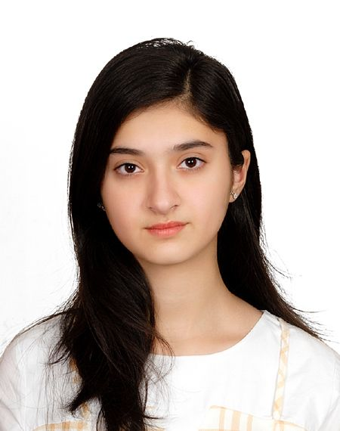

AGE: 20 YEARS. HEIGHT: 5ft 9inch. WEIGHT: 52KG. CURRENT LIFE ISSUE: INDECISIVE. PERSONALITY TRAIT: LOYAL, KIND, DEVOTED, SINCERE, DETERMINANT, COOPERATIVE, OPTIMISTIC.
ZARNAB ZAFAR

Slide 3

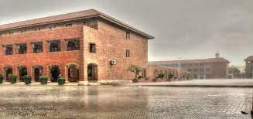

QUALIFICATIONS
O LEVEL IN PRE-MEDICAL -
- THE CITY SCHOOL P.A.F. CHAPTER-
A LEVEL IN COMMERCE -
- ALPHA COLLEGE -
BBA (IN PROGRESS) -
- THE INSTITUTE OF BUSINESS -ADMINISTRATION KARACHI. -

Slide 4


SKILLS
-FICTIONAL WRITING -INTERIOR DESIGNING -CONCRETE BASIC KNOWLEDGE OF MICROSOFT OFFICE -MENTAL FLEXIBILTY -LEADERSHIP SKILLS -MULTILINGUAL

Slide 5
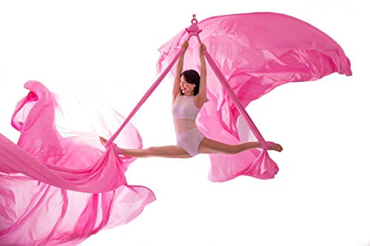
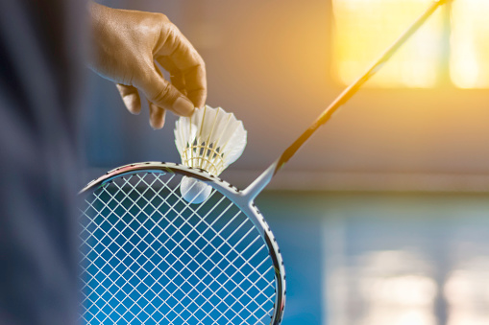
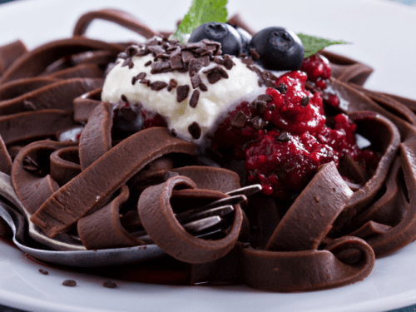
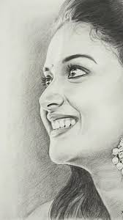
HOBBIES
AERIAL SILKS
SKETCHING
COOKING
BADMINTON
NETBALL
HANDBALL

Slide 6



LIKES AND DISLIKES
LIKES
DISLIKES
FOOD
CATS
TRAVELLING
SPORTS
MUSIC
ANIME
NATURE
VIDEO GAMES
DOGS
INSECTS
PLANE
DOCUMENTARIES
MEAN PEOPLE
LIES

Slide 7

DREAMS
I HAVE MANY DREAMS SUCH AS LIVING AND TRAVELLING IN A VAN,SKY DIVING, SCUBA DIVING, PERFORMING SILKS PROFESSIONALLY, DEVELOPING MY OWN APP, AND COOKING FOR A FIVE STAR RESTAURANT.

Slide 8
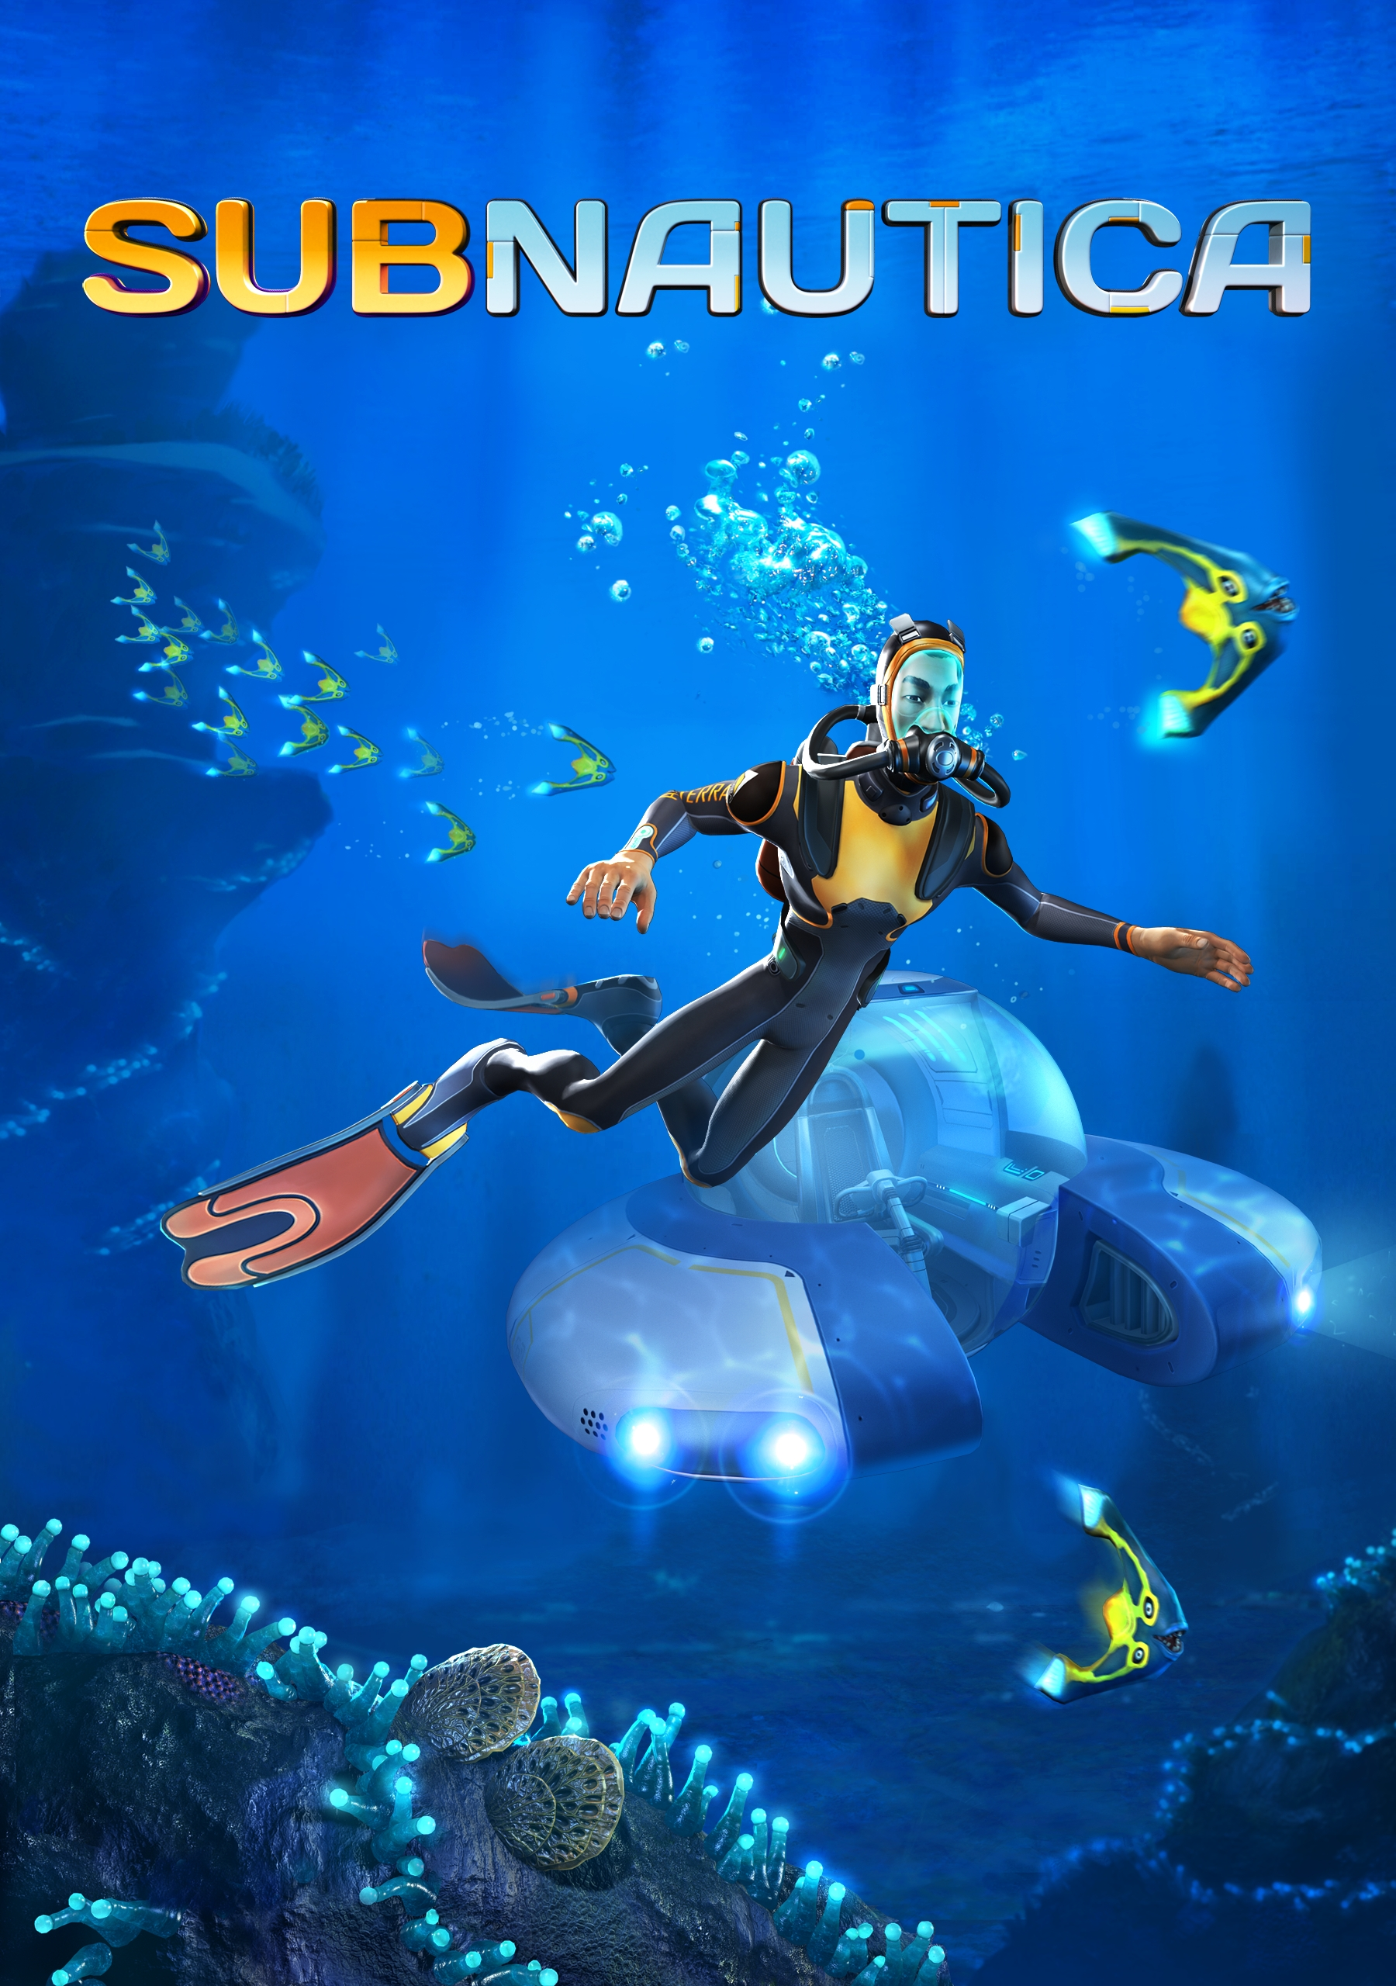
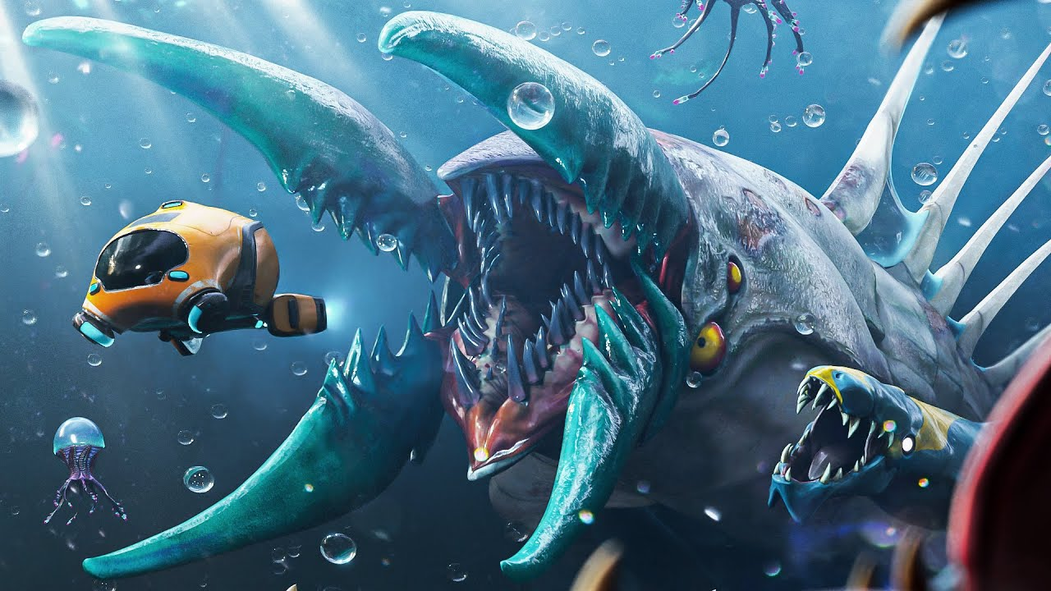
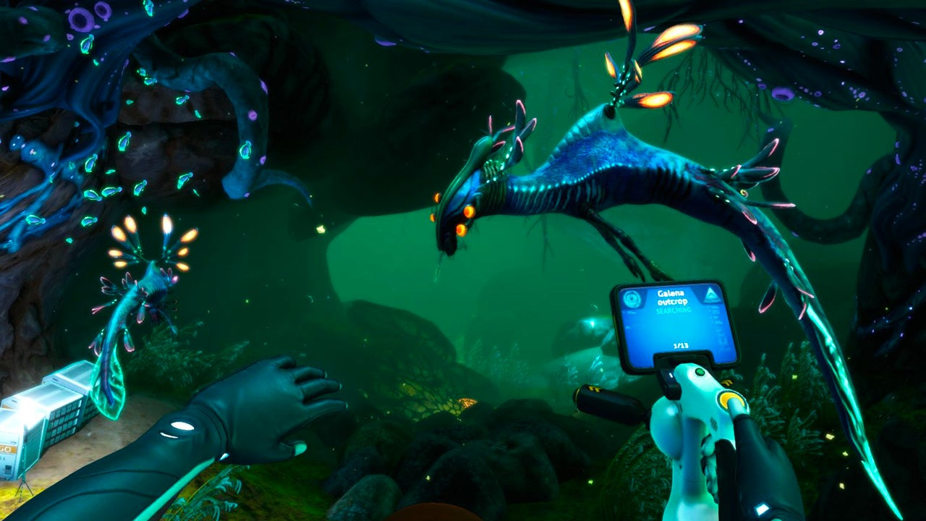
SUBNAUTICA
MY FAVORITE VIDEO GAME SO FAR HAS BEEN SUBNAUTICA. THE ATMOSPHERE AND AMBIENCE OF THE GAME IS WHAT MAKES IT SO INTERESTING FOR ME. I LIKE THIS SOUNDTRACK THE MOST FROM THIS VIDEO GAME.

Slide 9
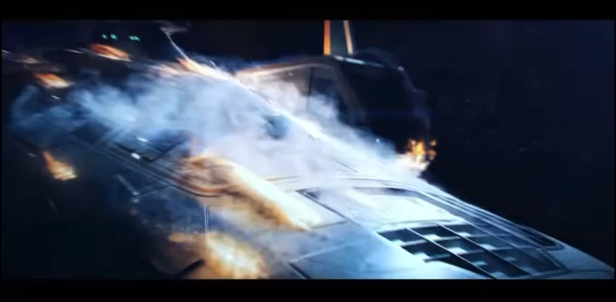

Slide 10
IN CONCLUSION, I AM A BBA STUDENT WITH DIVERSE DREAMS AND INTERESTS.
THANK YOU FOR FOLLOWING THROUGH THE WHOLE PRESENTATION.
ZARNAB ZAFAR (24589)

